Slide 1

Capstone Thesis Presentation
SIM2WIN: A TEAM AGNOSTIC, EVENT-BASED PRE-MATCH TACTICAL RECOMMENDATION SYSTEM FOR FOOTBALL
Mouad Zemzoumi
Supervised by: Dr. Amine Abouaomar
github.com/Mouad-Ze/SIM2WIN
May 2026

Slide 2
Agenda
Introduction
Methodology
Litterature Review & Research Gaps
Limitations & Future Work
Results and Findings
Conclusion

Slide 3
Introduction
Football is no longer just a sport; it is a high-density data environment where every second generates thousands of data points.
Despite having access to granular event data for every pass and pressure, many pre-match tactical decisions are still driven by subjective "expert" intuition and historical reputation.
We are in an era where machine learning can decode the "DNA" of a team’s playstyle. Sim2Win moves beyond simple forecasting to provide a data-driven, tactical compass for coaching staff.
1
2

Slide 4
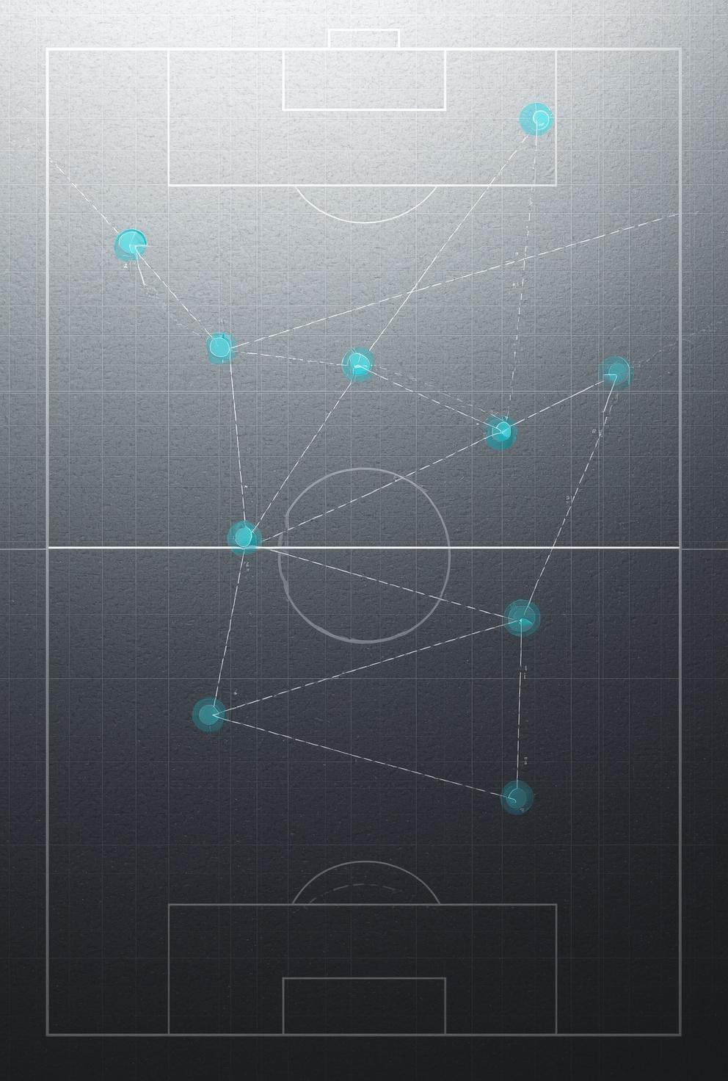
Litterature Review & Research Gaps

Slide 5

Litterature Review (Match Outcome prediction)
Machine Learning Dominance
Behavioral Modeling
Classification is the primary methodology for predicting discrete match outcomes (Moya et al., 2025).
Playing styles can be identified using Exploratory Factor Analysis (EFA) and clustering applied to event statistics (Baattite, 2023).
Predictive Features
Home advantage, goal difference, and expected goals (xG) are consistently considered in literature as the most robust predictors of match outcomes across Football games.

Slide 6
Litterature Review (Traditional Rating Systems)
Elo-G
Pi-Rating
Assigns team strength via a scalar value; the "G" variant scales updates by goal margin to better capture dominance (Hvattum & Arntzen, 2010).
Uses score discrepancies (goal difference) and exponential recency weighting to prioritize current ability over historical reputation (Constantinou & Fenton, 2013).
GAP
Generalized Attacking Performance, Uses xG signals to separate attack and defense ratings for home and away contexts (Wheatcroft, 2021).

Slide 7
Litterature Review (Tactical & Event-Based Analysis)
Event Impact
Possession Context
Not all recorded events influence performance equally; metrics like possession and pass accuracy vary in impact depending on the quality of opposition (Liu et al., 2013)
Raw possession often has a low correlation with winning for mid-quality teams; directness (passes per possession) is a more accurate tactical descriptor (Collet, 2013).
Situational Variables
Physical intensity and tactical execution are heavily influenced by fatigue (days of rest) and match location (home/away) (Lago-Peñas & Pollard, 2013) .

Slide 8
Research Gaps
The Identity Trap
Passive Forecast
Established systems are "locked" to team names. If a team is newly promoted or has a rotating squad, these models fail because they lack historical "identity".
Most systems tell you if you will win, but they can't tell you how to win. They predict outcomes instead of recommending actionable tactics.
The Black Box Problem
Subjective scouting is expensive and slow, yet current AI models often lack the interpretability needed for a coach to trust them in a high-stakes match or a tailored for some specific teams/leagues.

Slide 9
Methodology

Slide 10
Data Architecture
Match Events
Aggregated matches (Per League)
Aggregated matches per season
Pre-Processing, Feature Engineering and Clustering.
Final Data

Slide 11
StatsBomb open data: 1,411 team-match rows, 178 unique teams, ~706 matches spanning 2003-2024.
Dataset & Competitions Overview
11 competitions: Bundesliga, Premier League, La Liga, FIFA World Cup, UEFA Euro, Women's World Cup…
52 Features including Tactical, Temporal and Contextual ones.
Applied chronological sorting, 1st/99th percentile Winsorization, and xG capping at 5.0 to ensure data stability among many other pre-processing steps.

Slide 12
Feature Engineering: Tactical Ratios
1
2
3
4
Pressing
Efficiency
Shot
Quality
Directness
Index
Chaos
Index
Ball Recoveries / (Pressures + ε)
Measures defensive intensity and ball winning effectiveness.
Expected Goals (xG) / (Shots + ε)
Measures the quality of scoring opportunities created, not just volume.
Passes / (Possession Events + ε)
Captures playing style from patient build-up to direct attacking play.
Fouls + 3×Yellow Cards + 5×Red Cards
Quantifies match disruption and disciplinary patterns.

Slide 13

Rolling Tactical Profiles & Contextual Features
5-Match Rolling Window
Estimating a pre-match tactical state, by computing all features over the last 5 matchs shifted by k=1 to avoid data leakage.
Volatility Features
Exctracted xG Volatility measures attacking consistency and xG Momentum to identify teams on a distinct upward or downward trajectory .
Contextual Enrichment
Two critical contextual features augment the tactical profile: Home/Away indicator captures venue advantage effects, while Days of Rest accounts for fatigue and recovery dynamics between matches.

Slide 14
Applied K-Means clustering to 13 rolling features to group team behaviors into archetypes.
While Mathematical Validation (Elbow/Silhouette) suggested 5, I selected K=8 for more tactical diversity.
Playstyle Clustering
PCA was explicitly avoided to ensure each cluster remains directly explainable in football terms.
All features were scaled using StandardScaler so that high-volume metrics like passes do not dominate the distance metric.

Slide 15
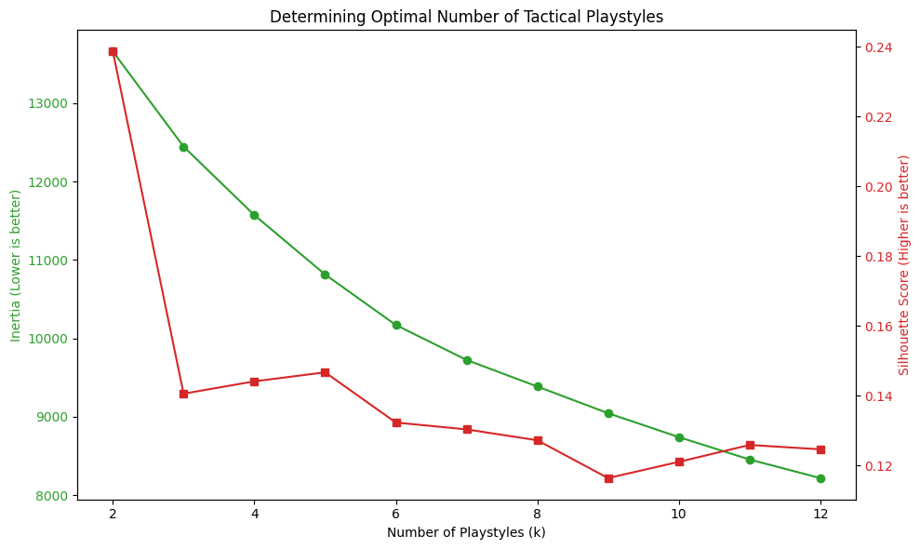

Slide 16
Cluster ID | Tactical Label | Defining Characteristics
0 | High-Pressing Possession | High Pass Volume, High Pressing Efficiency, High xG.
1 | Low-Block Counter | Negative Pressing, High Directness, Low Possession.
2 | Mid-Block Transition | Average Pressing, High Interceptions, Balanced Directness.
3 | Direct Long Ball | Peak Directness Index, Low Pass Accuracy, High Chaos Index.
4 | Tiki-Taka | Max Pass Volume, Peak Possession, High Shot Quality.
5 | Wing-Play Overload | High Shot Volume, Mid-Directness, Specific Formation Bias.
6 | High-Intensity Gegenpress | Max Pressures, Max Ball Recoveries, High xG Volatility.
7 | Park the Bus | Minimized xG, Max Chaos Index, Negative Pressing.

Slide 17
13 Models were trained on the same dataset.
These models included a variety of Ensemble methods and other Traditional Classifiers.
Modeling
Training Set used for model training and Hyper Parameter tuning via RandomizedSearchCV with 5-fold cross-validation.
The split was stratified to maintain the natural class distribution of Wins, Draws, and Losses across both sets.

Slide 18
Validation Framework
Rigorous Evaluation for Reliable Generalization
10-Fold Cross-Validation
All models evaluated with 95% confidence intervals to ensure statistical reliability and reproducibility of results, for the best performing models.
Statistical Significance Testing
McNemar's exact test applied for pairwise model comparisons, confirming performance differences are not due to chance.
Leave-One-Competition-Out (LOCO)
Novel evaluation protocol testing generalization to entirely unseen teams and competitions the true test of team-agnostic modeling.
8-Configuration Ablation Study
Systematic feature removal experiments to quantify the contribution of each feature group to model performance.

Slide 19
Results and Findings

Slide 20
Model | Accuracy (%) | Log Loss | ROC-AUC | F1-Score | Precision | Recall | Family
CatBoost† | 60.90 | 0.9289 | 0.7268 | 0.5817 | 0.5870 | 0.6090 | Boosting
Extra Trees | 59.40 | 0.9340 | 0.7325 | 0.5402 | 0.6112 | 0.5940 | Ensemble
LightGBM | 57.14 | 0.9345 | 0.7196 | 0.5173 | 0.5239 | 0.5714 | Boosting
XGBoost | 56.39 | 0.9271 | 0.7406 | 0.5186 | 0.5536 | 0.5639 | Boosting
Logistic Regression | 55.64 | 0.9207 | 0.7244 | 0.4894 | 0.4385 | 0.5564 | Linear
Gradient Boosting | 55.64 | 0.9393 | 0.7198 | 0.5126 | 0.5231 | 0.5564 | Boosting
Random Forest | 55.64 | 0.9414 | 0.7122 | 0.4890 | 0.4457 | 0.5564 | Ensemble
SVC (RBF Kernel) | 53.38 | 0.9575 | 0.7090 | 0.4429 | 0.4268 | 0.5338 | Kernel
Bagging Classifier | 53.38 | 0.9625 | 0.7006 | 0.5146 | 0.5158 | 0.5338 | Ensemble
ANN | 53.38 | 0.9679 | 0.6943 | 0.4820 | 0.4683 | 0.5338 | Neural
AdaBoost | 53.38 | 1.0094 | 0.6426 | 0.4641 | 0.4450 | 0.5338 | Boosting
K-Nearest Neighbors | 51.13 | 1.2392 | 0.6923 | 0.5027 | 0.4969 | 0.5113 | Instance
TabPFN | 41.35 | 1.0887 | 0.6307 | 0.3080 | 0.4892 | 0.4135 | Foundation
Key Results: Models Performance

Slide 21
Key Results: Training Cv vs Test
Model | Train Accuracy (CV) | Test Accuracy (Holdout) | Difference
CatBoost | 55.50% ± 2.45% | 60.90% | +5.40%
Extra Trees | 54.91% ± 3.93% | 59.40% | +4.49%
XGBoost | 52.49% ± 4.58% | 56.39% | +3.90%

Slide 22
Key Results: McNemars test
Model | Accuracy | F1-Score | McNemar p-value | Binary Size
CatBoost | 60.90% | 0.582 | — | 428 KB
Extra Trees | 59.40% | 0.540 | 0.4807 | 1,800 KB
XGBoost | 56.39% | 0.519 | 0.1221 | 1,900 KB
Log. Regression | 55.64% | 0.489 | 0.0009 | < 10 KB

Slide 23
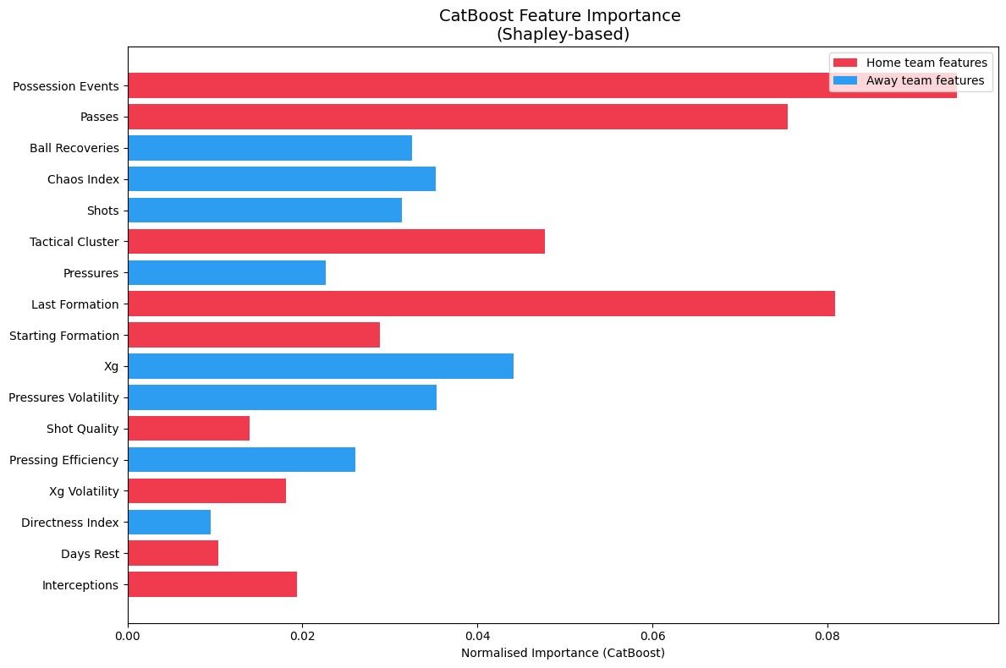
Key Results: Features Importance

Slide 24
Ablation Study Insights
1
Feature Removal Impact
2
Window & Baseline Analysis
Removing volatility features: -1.66%
Removing contextual features: -1.21%
Tactical cluster removal: -0.91%
Engineered ratios removal: -0.15%
Window size variations (3 or 7 matches) reduce accuracy by approximately 4%
Raw features with data leakage artificially boost accuracy +7.1% (Hence the shift by 1 in the rolling matches)

Slide 25
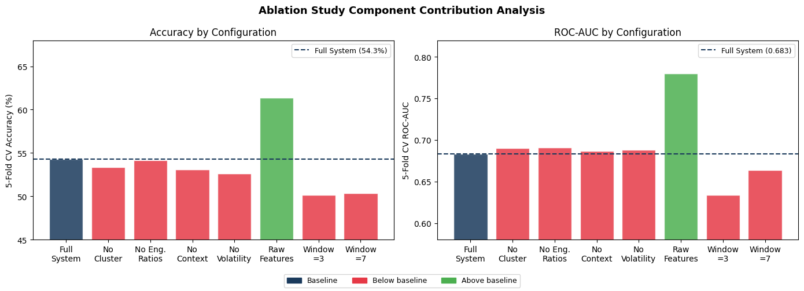

Slide 26
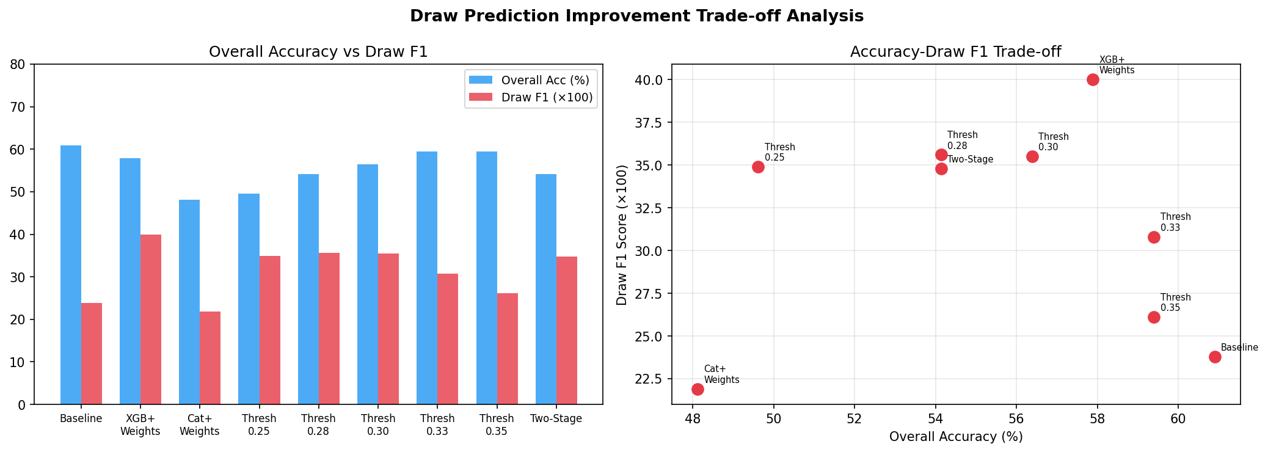
Draw Trade-off Analysis
Mean Accuracy: 55.4% vs 42.5% baseline, consistently outperforming across all competitions
Mean ROC-AUC: 0.704
Strongest Performance: La Liga (65% accuracy, AUC 0.796) .
Weakest Performance: AFCON (45% accuracy, AUC 0.562).

Slide 27
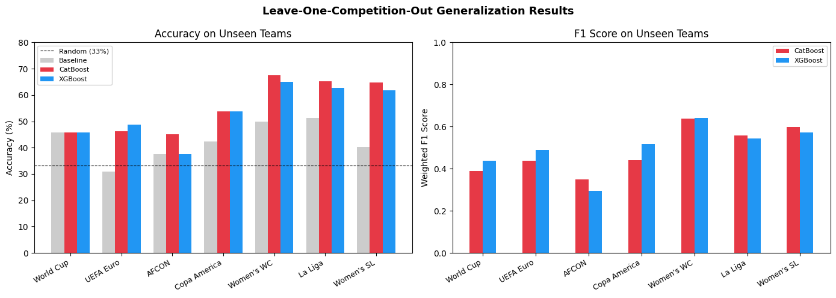
LOCO Generalization: Performance on Unseen Teams
Mean Accuracy: 55.4% vs 42.5% baseline, consistently outperforming across all competitions
Mean ROC-AUC: 0.704
Strongest Performance: La Liga (65% accuracy, AUC 0.796) .
Weakest Performance: AFCON (45% accuracy, AUC 0.562).

Slide 28
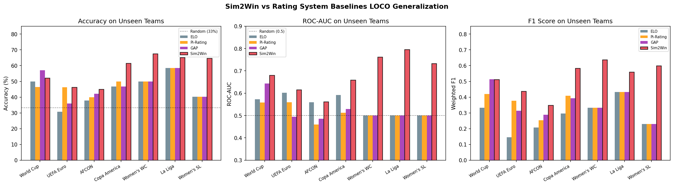
Comparison Against Traditional Rating Systems
Sim2Win vs Identity-Based Systems
Sim2Win demonstrates clear superiority with 0.704 mean AUC, significantly outperforming ELO-G (0.567), Pi-Rating (0.551), and GAP (0.548). Results validated across 21/21 AUC comparisons and 19/21 accuracy comparisons.

Slide 29
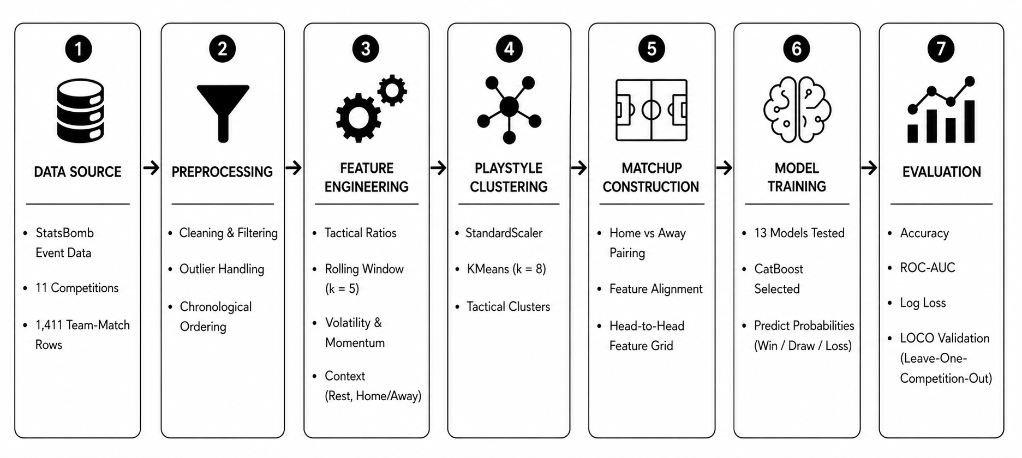
System Architecture

Slide 30
LIVE DEMONSTRATION
Proof of Concept

Slide 31
Limitations & Future Work
Limitations
Future Research Directions
• Dataset Size is Small in contrast with modern Football Demand.
• Draw prediction remains challenging
• Missing finer context (injuries, weather)
• Aggregate stats lose spatial/temporal detail
•Missing dynamic in-match dynamic tactical shifts data.
• Expand dataset balance and seasons
• Integrate multimodal data (heatmaps, tracking).
• Hybrid modeling combining ratings and tactics.
• Improved draw prediction methods.
• Add contextual enrichment (player, weather, referee).
1
2

Slide 32

Conclusion
In the high-stakes theater of modern football, the margin between victory and heartbreak is often a single tactical pivot. Sim2Win was born from the vision to replace gut feeling with ground truth.
As we move from pre-match simulations to the future of real-time spatial intelligence, Sim2Win stands as a definitive proof that the beautiful game is no longer just played on grass.
In ninety minutes of chaos, the data provides the evidence, but Sim2Win provides the edge.

Slide 33
Mouad Zemzoumi
THANK YOU
Questions? Let's discuss Sim2Win.
github.com/Mouad-Ze/SIM2WIN
May 2026

